Slide 1
ALCOHOL
The effects of alcohol on the body

Slide 2
WHAT IS ALCOHOL?
Alcohol is a drug. It is classed as a depressant,
  meaning that it slows down vital functions
Although classified as a depressant, the amount of alcohol consumed determines the type of effect.
There are different kinds of alcohol.
  Ethyl alcohol (ethanol), the only alcohol used in beverages
    produced by the fermentation of grains and fruits.

Slide 3
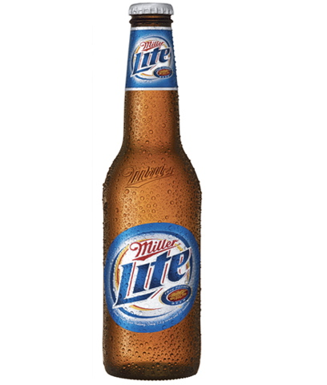
WHAT’S A DRINK? - BEER
12 ounces of alcohol
4.2% alcohol
12 x .042 =
0.504
0.504
Total amount of alcohol

Slide 4
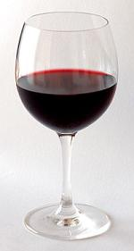
WHAT’S A DRINK? - WINE
5 ounces
13 % alcohol
5 x .13 =
0.65
0.65
Total amount of alcohol

Slide 5
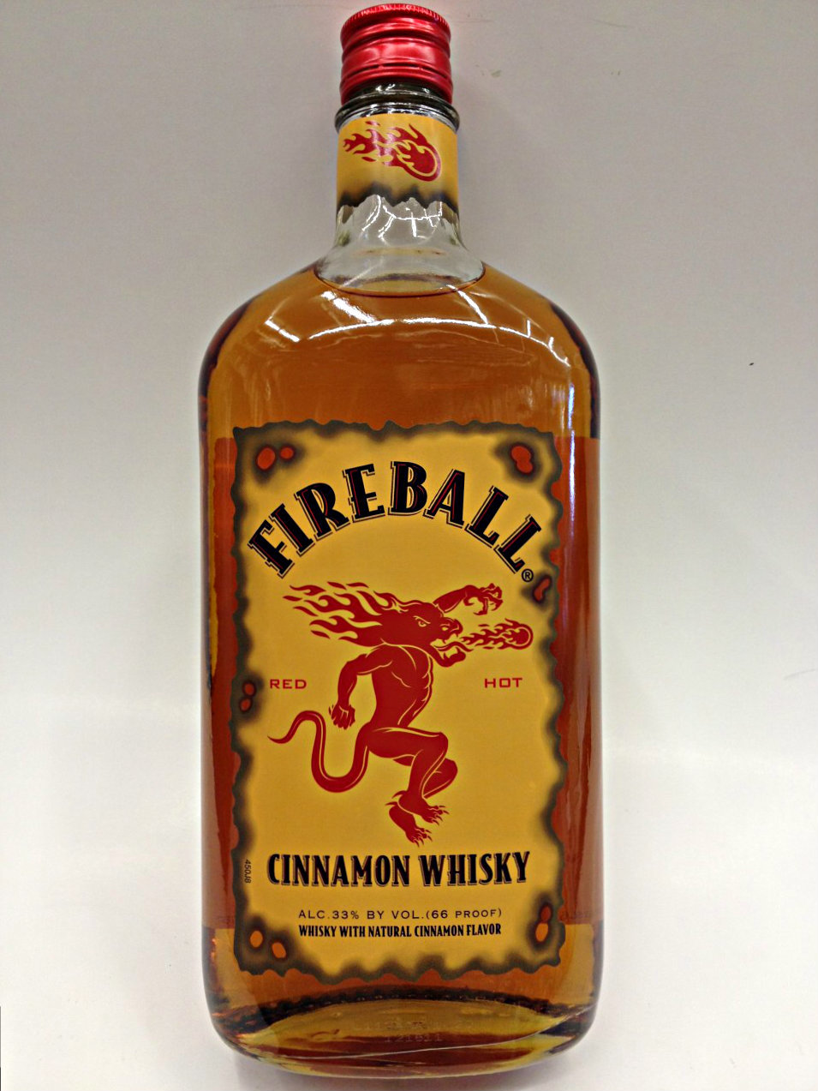
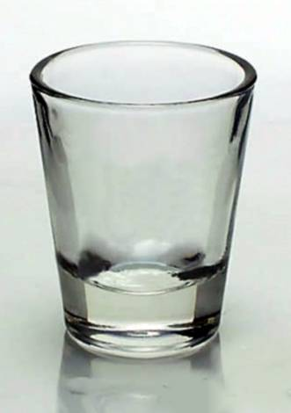
WHAT’S A DRINK? - LIQUOR
1.5 ounces
33 % alcohol
1.5 x .33 =
0.495
0.495
Total amount of alcohol

Slide 6
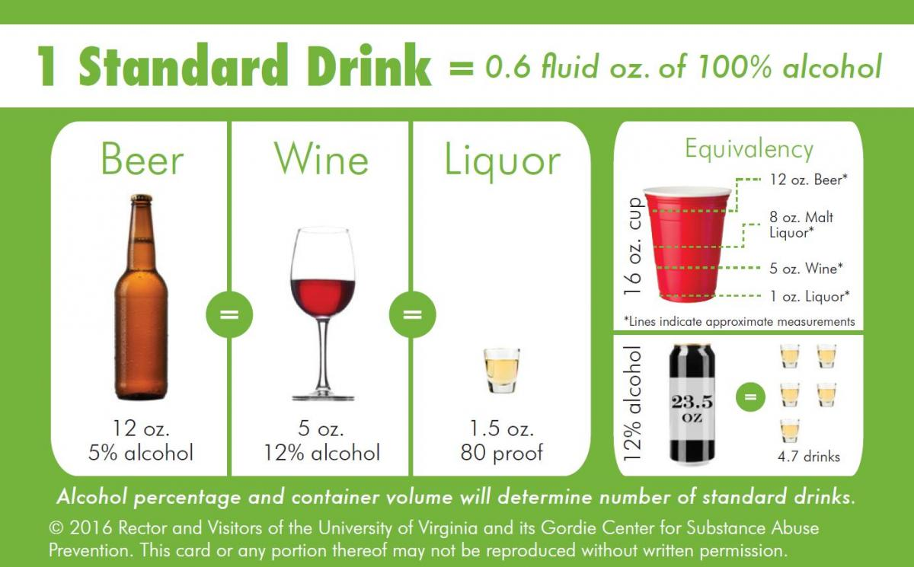

Slide 7
BLOOD ALCOHOL CONTENT
What are some factors that affect an individual’s BAC??
B.A.C.

Slide 8
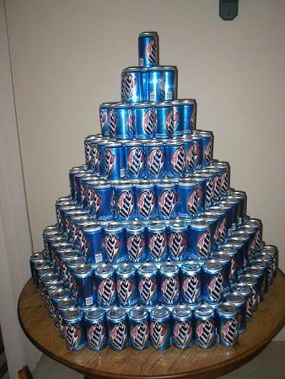
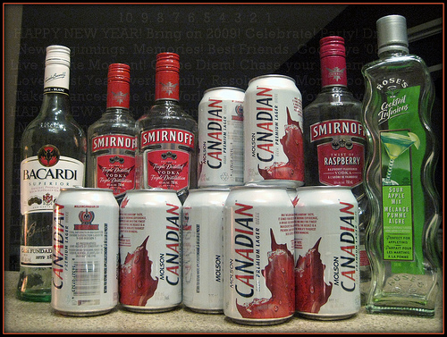
AMOUNT OF ALCOHOL CONSUMED

Slide 9
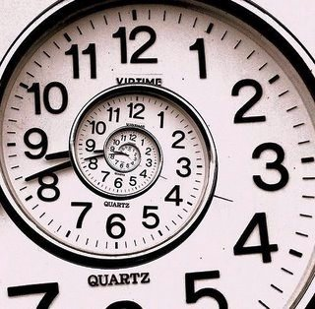
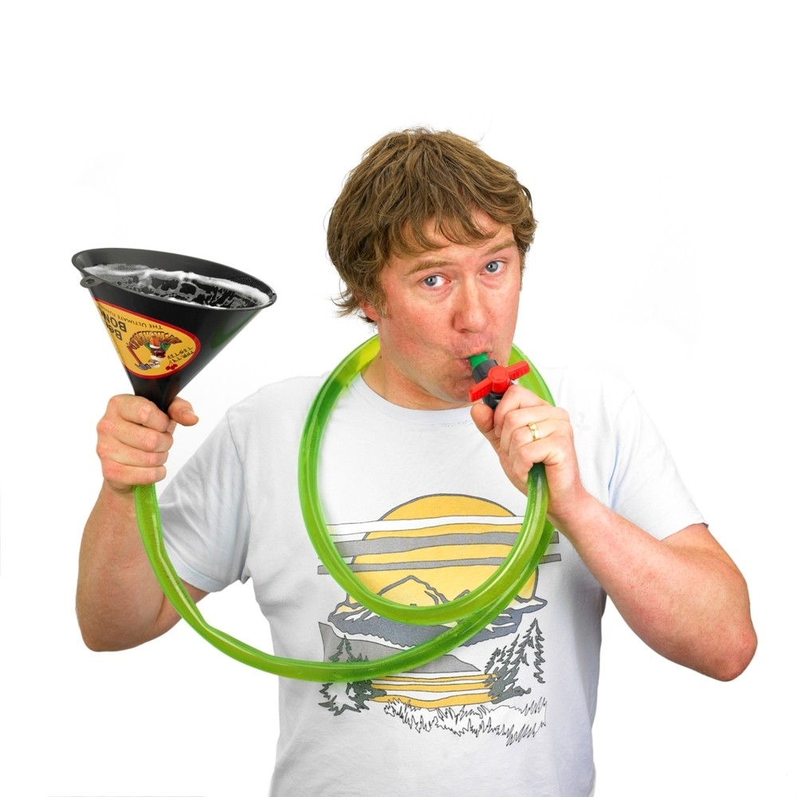
TIME CONSUMED

Slide 10
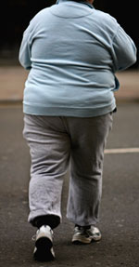
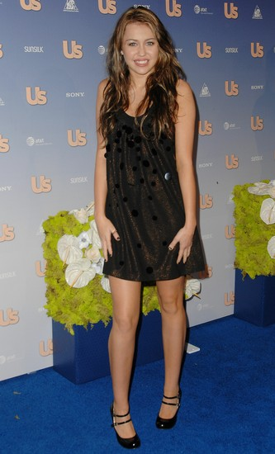
BODY WEIGHT

Slide 11
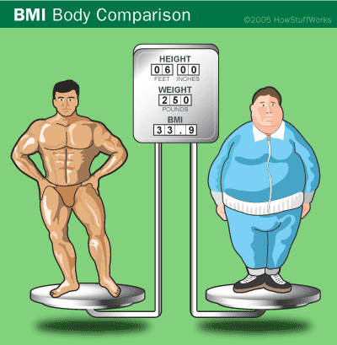
PERCENT OF BODY FAT

Slide 12

GENDER

Slide 13

FEELINGS

Slide 14
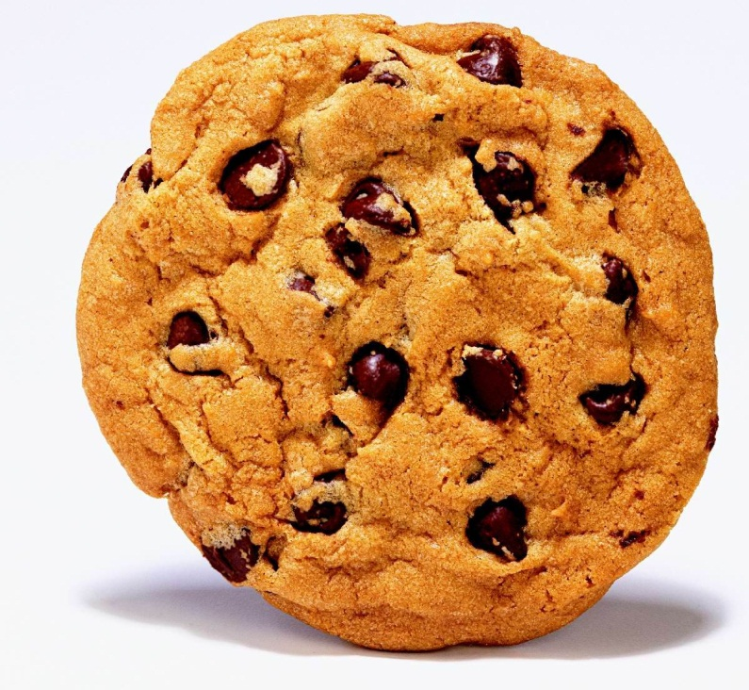
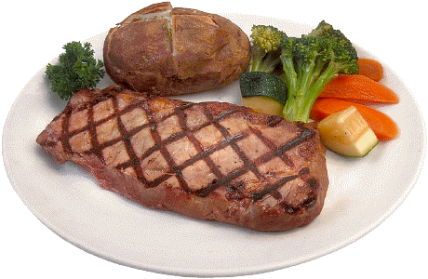
AMOUNT OF FOOD CONSUMED

Slide 15
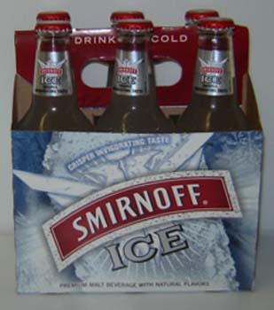
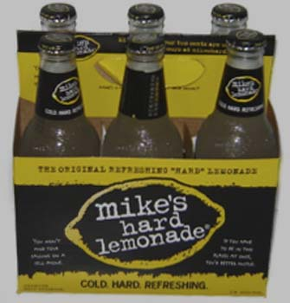
DRINKING CARBONATED DRINKS

Slide 16
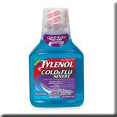
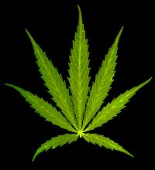
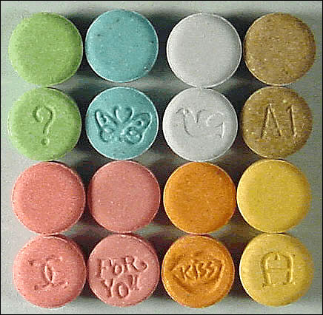
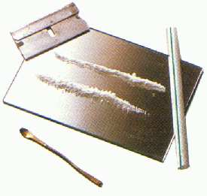
PRESENCE OF OTHER DRUGS

Slide 17


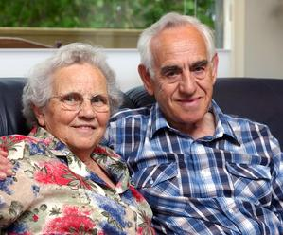
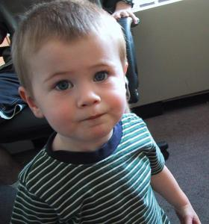
AGE

Slide 18
SHORT TERM EFFECTS OF ALCOHOL
Distorted vision and hearing
Impaired judgment
Decreased perception and coordination
Unconsciousness
Alcohol poisoning
Coma
Blackouts
Intentional injuries such as firearm injuries, sexual assault, domestic violence
Slurred speech
Drowsiness
Vomiting
Diarrhea
Upset stomach
Headaches
Breathing difficulties
Unintentional injuries such as car crash, falls, burns, drowning

Slide 19
LONG TERM EFFECTS OF ALCOHOL
Increased on-the-job injuries and loss of productivity
Increased family problems, broken relationships
Anemia
High blood pressure, stroke, and other heart-related diseases
Liver disease
Nerve damage
Sexual problems
Permanent damage to the brain
Vitamin B₁ deficiency, Ulcers
Gastritis (inflammation of stomach walls)
Malnutrition
Cancer of the mouth and throat

Slide 20
TEEN BRAINS ON ALCOHOL
Video: Dr. Aaron White

Slide 21
Alcohol and the Teenage Brain
    What part of the brain did Dr. White say was most affected by teenage drinking?
      HIPPOCAMPUS
    What function does the hippocampus serve?
      LEARNING AND MEMORY
    When did he say the most damage occurs?
      THE HANGOVER STATE

Slide 22
THE BRAIN

Slide 23
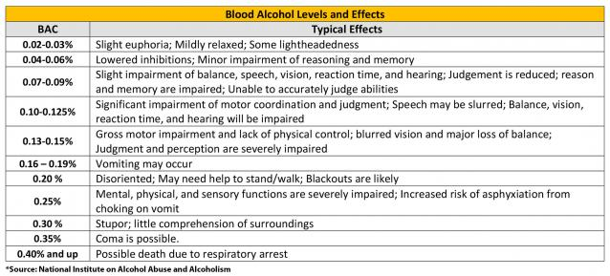
BAC EFFECTS

Slide 24
THE BUZZED ZONE
Euphoria
Feelings of warmth
Relaxation
Loss of shyness
Lowered inhibitions
Judgement somewhat impaired
.01 - .05

Slide 25
THE DRUNK ZONE
Impairment of reaction time & muscle control.
Judgement further impaired
Mood swings
Possible embarrassing behavior
Legal limit for driving – 21& over : .08
Impaired sexual performance
.06 - .11

Slide 26
THE ELEVATED RISK ZONE
Vomiting likely
Balance and movement substantially impaired
Risk of injury
Very poor decision making.
.12 - .15

Slide 27
THE HIGH RISK ZONE
“Alcohol Blackout” likely
Loss of consciousness possible.
Risk of choking on vomit.
.16 - .25

Slide 28
THE MEDICAL EMERGENCY ZONE
Loss of consciousness.
Risk of choking on vomit
.45 = Fatal BAC in 50% of population
Loss or slowing of involuntary reflexes
Death
.25 +

Slide 29
WOMEN
MEN
Drinks per HOUR | 100 | 120 | 140 | 160 | 180 | 200 | 220
1 | 0.05 | 0.04 | 0.03 | 0.03 | 0.03 | 0.02 | 0.02
2 | 0.09 | 0.08 | 0.07 | 0.06 | 0.05 | 0.05 | 0.04
3 | 0.14 | 0.11 | 0.10 | 0.09 | 0.08 | 0.07 | 0.06
4 | 0.18 | 0.15 | 0.13 | 0.11 | 0.10 | 0.09 | 0.08
5 | 0.23 | 0.19 | 0.16 | 0.14 | 0.13 | 0.11 | 0.10
6 | 0.27 | 0.23 | 0.19 | 0.17 | 0.15 | 0.14 | 0.12
7 | 0.32 | 0.27 | 0.23 | 0.20 | 0.18 | 0.16 | 0.14
8 | 0.36 | 0.30 | 0.26 | 0.23 | 0.20 | 0.18 | 0.17
9 | 0.41 | 0.34 | 0.29 | 0.26 | 0.23 | 0.20 | 0.19
10 | 0.45 | 0.38 | 0.32 | 0.28 | 0.25 | 0.23 | 0.21
Drinks per HOUR | 120 | 140 | 160 | 180 | 200 | 220 | 240
1 | 0.03 | 0.03 | 0.02 | 0.02 | 0.02 | 0.02 | 0.02
2 | 0.06 | 0.05 | 0.05 | 0.04 | 0.04 | 0.03 | 0.03
3 | 0.09 | 0.08 | 0.07 | 0.06 | 0.06 | 0.05 | 0.05
4 | 0.12 | 0.11 | 0.09 | 0.08 | 0.08 | 0.07 | 0.06
5 | 0.16 | 0.13 | 0.12 | 0.11 | 0.09 | 0.09 | 0.08
6 | 0.19 | 0.16 | 0.14 | 0.13 | 0.11 | 0.10 | 0.09
7 | 0.22 | 0.19 | 0.16 | 0.15 | 0.13 | 0.12 | 0.11
8 | 0.25 | 0.21 | 0.19 | 0.17 | 0.15 | 0.14 | 0.13
9 | 0.28 | 0.24 | 0.21 | 0.19 | 0.17 | 0.15 | 0.14
10 | 0.31 | 0.27 | 0.23 | 0.21 | 0.19 | 0.17 | 0.16

Slide 30
EXAMPLE: Guest #1: Maggie – 115lb. female
HOUR | 12:00 – 1:00 | 1:00 – 2:00 | 2:00 – 3:00 | 3:00 – 4:00 | 4:00 – 5:00
Number of Drinks | 1 | 2 | 1 | 1 | 0
BAC (start of hour)
BAC from table
BAC after
Alcohol broken down | 0.02 | 0.02 | 0.02 | 0.02 | 0.02
BAC (end of hour)
BAC at the end of the party: ________________________________________________________
Should guest drive home? ________________________________________________________
When will guest be completely sober? __________________________________________________

Slide 31
Consequences of Underage Drinking
Academic Failure
Alcohol Poisoning
Alcoholism
Alterations in brain development
Criminal behavior
Fetal Alcohol Syndrome
Blurred Vision
Hangover
Injury
Liver Damage
STDs
Unintended Pregnancy
Traffic Crashes
Bad Reputation
Slurred Speech
Loss of Balance and coordination
Slowed Breathing
Passed out
Black Out
Legal problems
Violence
Death

Slide 32
I’ll Pass…
Financial:
4, 6, 8, 26
Academic:
3, 12, 18, 27
Neurological:
10, 13, 17, 22
Physical:
1, 7, 15, 23
Social:
5, 14, 20, 24
Legal:
2, 11, 21, 28
Consequences for Others:
9, 16, 19, 25

